Slide 1
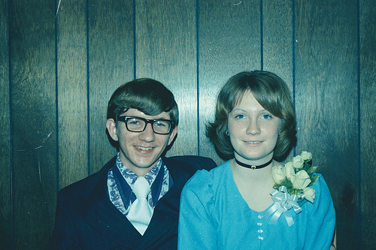
3.3 The Addition Rule
“Baby…I know how to add.”
Statistics
Mr. Laurence

Slide 2
Objectives:
In the last section, you learned how to find probabilities of two events, A and B, occurring in sequence. In this section, you will learn how to find the probability that at least one of the events will occur.
You will learn how to determine if two events are mutually exclusive.
You will learn how to use the Addition Rule to find the probability of two events.

Slide 3
Mutually Exclusive Events:
Two events, A and B, are mutually exclusive if A and B cannot occur at the same time.
Example:
Event A: Rolling a 3 on a die.
Event B: Rolling a 4 on a die.
Since event A has an outcome, a 3, and event B has an outcome, a 4, these outcomes cannot occur at the same time.

Slide 4

Mutually Exclusive or not?
Event A: Randomly selecting a male student.
Event B: Randomly selecting a nursing major.
Event A: Randomly selecting a blood donor with type O blood.
Event B: Randomly selecting a female blood donor.
Event A: Randomly selecting a Ford.
Event B: Randomly selecting a Toyota.

Slide 5
The Addition Rule:
The probability that events A or B will occur, P (A or B), is given by:
P( A or B) = P (A) + P (B) – P(A and B).
If events A and B are mutually exclusive, then the rule can be simplified to P(A or B) = P(A) + P(B)

Slide 6
Using the Addition Rule to find Probabilities:
You select a card from a standard deck. Find the probability that the card is a 4 or an ace.
You roll a die. Find the probability of rolling a number less than 3 or rolling an odd number.

Slide 7
Solution # 1:
You select a card from a standard deck. Find the probability that the card is a 4 or an ace.
The probability of getting a 4 is 4/52 and the probability of getting an ace is 4/52, so if you add them together the probability is 8/52 or 4/13.

Slide 8
Solution # 2:
You roll a die. Find the probability of rolling a number less than 3 or rolling an odd number.
The probability of rolling a number less than 3 is 2/6. The probability of rolling an odd number is 3/6. So 2/6 + 3/6 = 5/6, but one of the numbers less than 3 is odd, so we can’t double count. So 5/6-1/6 = 4/6 or 2/3.

Slide 9
You try:
A die is rolled. Find the probability of rolling a 6 or an odd number.
A card is selected from a standard deck. Find the probability that the card is a face card or a heart.

Slide 10
Solution:
A die is rolled. Find the probability of rolling a 6 or an odd number.
4/6 or 2/3.
A card is selected from a standard deck. Find the probability that the card is a face card or a heart.
16/52 + 13/52 – 4/52 = 25/52

